Slide 1
DETECT, SEPARATE AND MATCH INDIVIDUAL FROM A SURVEILLANCE CAMERA USING FACE RECONGNITION MECHANISM
FINAL REVIEW PRESENTATION

Slide 2
TEAM DESCRIPTION
SHREE KISHORE S
VISHNU PRAKASH L
VINAY S
111519104137
Department of Computer Science
Engineering
111519104174
Department of Computer Science
Engineering
111519104174
Department of Computer Science
Engineering
Mrs. K. BALASARANYA
OUR TEAM
MENTOR:
ASSISTANT PROFESSOR
Department of
Computer Science
Engineering

Slide 3
PAGE OF CONTENTS
01
04
DOMAIN OF THE PROJECT
INTRODUCTION
02
LITERATURE SURVEY
03
04
05
RESULT
SNAPSHOTS
06
METHODOLOGY
CONCLUSION

Slide 4
ABSTRACT
Finding and tracking someone in the realm of technology is now a requirement for a number of security reasons. Since the invention of technology, advances in the field of facial recognition have become increasingly significant in today's society.
The security cameras are linked. All people are listed in a database on the server. If an unknown person is seen in a particular feed of the video from a particular camera, an alarm message is sent to the owner through email.

Slide 5
ABSTRACT
In this project, we are developing a tool that can automatically detect, separate and identify individuals from surveillance camera footage. The tool will use advanced computer vision and machine learning techniques to analyze the video and locate the faces of each person captured by the camera.
Once identified, the tool will separate the faces from the background and create individual images for each person. Then, it will use facial recognition technology to match the individual images with a pre-existing database of known individuals.

Slide 6
01
INTRODUCTION
DEFINITION AND GENERAL STUFFS

Slide 7
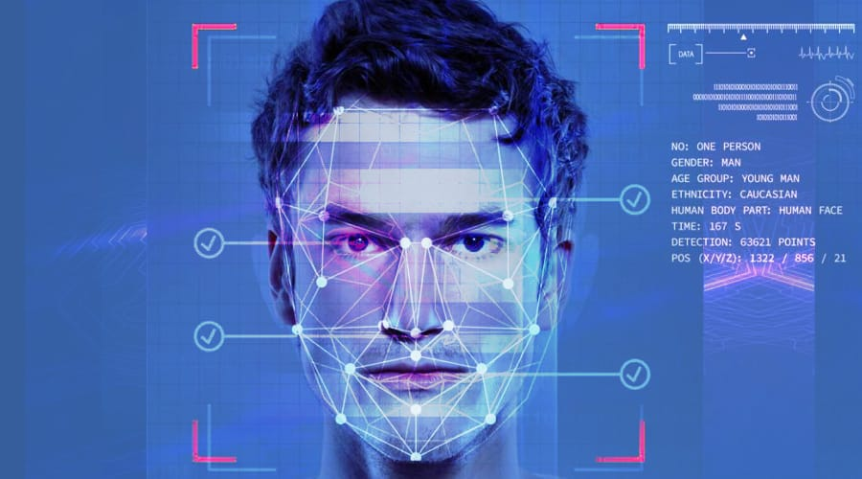
INTRODUCTION
Face recognition has been an integral part in computer world and an area where machine learning can be done. In the past various evolutionary techniques have been used to learn face recognition.
But face recognition from a single image is a tiring task due to its high quality. Designing a system for image recognition has various limitations in real time
Face recognition in digital images is used in manufacturing industries, surveillance in public places, identification of criminals and in intelligence.

Slide 8
EXISTING SYSTEM VS PROPOSED SYSTEM

Slide 9
EXISTING SYSTEM
The existing shrewd observation frameworks video recorded and checking through PC or savvy TV. It won't cosy or alarm if any unusual condition happens and it requires manual intercession moreover. However, it is very not convincible to pass judgment on suspicious conduct by a solitary checking. It possibly bodes well to regard the meandering as doubt when it happens over and again or takes quite a while.
The Disadvantages of pass-thought authentication include the requirement for authentications

Slide 10

PROPOSED SYSTEM
We propose a method in which a device is built by simply providing facial recognition of the person and the device that can be considered a useful system for detecting unknown person .Using cascade file and database details to find unknown persons or not.
If systems find unknown person then alert message send to authorized person through email. Most of the latest facial recognition software in the marketplace integrates easily with security systems. The convenience and accuracy afforded by facial recognition to secure borders, and prevent criminal activities is paramount.

Slide 11
ADVANTAGES
Improved security
Alert system
Effortless integration
Prevent Crime activity
Recognises multiple persons at a time.
No need of security admin to surveillance all the time
Entry time of each person can be saved and retrieved

Slide 12
SYSTEM SPECIFICATIONS

Slide 13
HARDWARE CONFIGURATION
i5
8GB
SPEED
PROCESSOR
RAM (Minimum)
3GHZ

Slide 14
HARDWARE CONFIGURATION
HARDWARE DEVICES
500 GB
HARD DISK
WEB CAMERA
Basic, Standard Devices

Slide 15
SOFTWARE CONFIGURATION
Operating System
Server
Front End
Linux, Windows 7/8/10
Anaconda, VS code
Flask

Slide 16
SOFTWARE CONFIGURATION
Server side Script
Database
Linux, Windows 7/8/10
MySQL Workbench

Slide 17
02
LITERATURE SURVEY

Slide 18
This literature review is a comprehensive summary of previous research on a topic. The literature review surveys scholarly articles, books, and other sources relevant to a particular area of research. The review should enumerate, describe, summarize, objectively evaluate and clarify this previous research

Slide 19
S.NO | TITLE | AUTHOR NAME | YEAR OF PUBLISHING | DESCRIPTION
1 | A Survey on Deep Learning for Person Re-identification in Video Surveillance | M. Saquib Sarfraz | 3 March 2021 | Discussed about various deep learning-based approaches for person re-identification, including convolutional neural networks, Siamese networks, and triplet loss networks
2 | A Review of Face Detection and Face Recognition Techniques in Surveillance System. | E. Mohd Azmi | 01 Jan 2018 | Comprises face detection and recognition techniques, including both traditional and deep learning-based approaches

Slide 20
S.NO | TITLE | AUTHOR NAME | YEAR OF PUBLISHING | DESCRIPTION
3 | Facial Recognition for Surveillance Purposes: A Comprehensive Survey | R. Singh and D. Singh | 07 November 2020 | Covers recent advances in facial recognition technology, including feature-based, appearance-based, and 3D-based techniques, and their performance analysis
4 | Person identification from gait analysis with a depth camera at home | Amandine Dubois, BreJean-Pierre sciani. | 05 November 2015 | The gait analysis contains gait sequences which detects the visibility of the person using previously presented results on activity recognition based on Hidden Markov Models (HMMs).

Slide 21
03
METHODOLOGY
MODULES AND ALGORITHMS

Slide 22
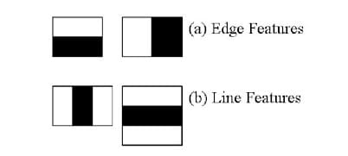
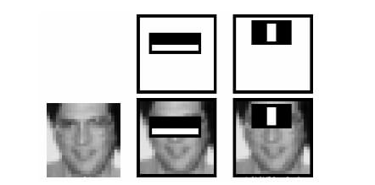
Haar Cascade Algorithm
Haar cascade is an algorithm that can detect objects in images, irrespective of their scale in image and location.
This cascade function is trained from a lot of positive and negative images. Here positive images are the samples which contain the target object and negative are the ones which don’t. It takes a lot of positive and negative samples to train the classifier.
we extract the features from the given input image with the haar features shown in the above image. They are just like convolutional kernels. Each feature is a single value obtained by subtracting the sum of pixels under the white rectangle from the sum of pixels under the black rectangle.

Slide 23
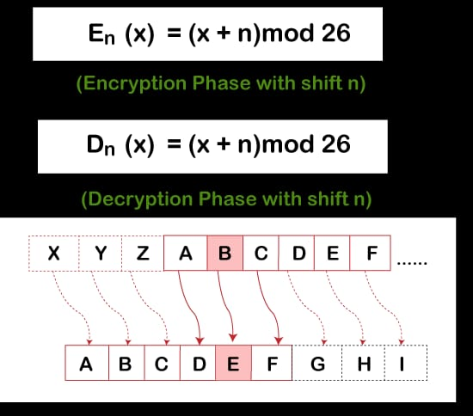
Caesar Cipher Encryption Algorithm
The Caesar cipher is based on transposition and involves shifting each letter of the plaintext message by a certain number of letters, historically three. This improves better Privacy

Slide 24
MODULE DESCRIPTION
Find recognize unknown or not
01
Video capturing
03
Better Password Security
04
02
Take input frame
Projectdc
05
Email sent

Slide 25
1.Video capturing
In OpenCV, to capture/create an Image or Video we use the VideoCapture() method which allows us to capture the video stream from our webcam.
You can see in the above code statement that, the VideoCapure() method accepts an integer value as an argument. This integer value represents the camera connected to the device.

Slide 26
2. Take input frame
Take a video as input and break the video into frame by frame and save those frames. Now, a number of operations can be performed on these frames.

Slide 27
3.Find recognize unknown or not
Using cascade file and database details to find unknown persons or not.

Slide 28
4.Better Password Security
While entering the password, Caesar Cipher Encryption Algorithm has been used. So the hackers or intruders may find difficult to guess the password correctly. This leads to enhanced password security.

Slide 29
5 .Email sent
If systems find unknown person then alert message send to authorized person through email, When the password is typed incorrect.

Slide 30
04
DOMAIN OF THE PROJECT

Slide 31
PYTHON
Python is an interpreter, object-oriented, high-level programming language with dynamic semantics. Its high-level built in data structures, combined with dynamic typing and dynamic binding; make it very attractive for Rapid Application Development, as well as for use as a scripting or glue language to connect existing components together.
Python's simple, easy to learn syntax emphasizes readability and therefore reduces the cost of program maintenance. Python supports modules and packages, which encourages program modularity and code reuse.

Slide 32
Face Recognition with the Python face_recognition Library
r
To set up the libraries required for face recognition through Python:
1. Go to the terminal and download the dlib library:
pip install dlib
The dlib library is a C++ toolkit that features machine learning tools and algorithms. It is important to install it to use the face_recognition library.
2. Use the following command to install the face_recognition library:
pip install face recognition
3. Use the following command to download the OpenCV library:
pip install opencv
4. Use the following commands to install other relevant libraries:
import cv2 import numpy as np import face_recognition as faceRegLib

Slide 33

PYCHARM
PyCharm is a dedicated Python Integrated Development Environment (IDE) providing a wide range of essential tools for Python developers, tightly integrated to create a convenient environment for productive Python, web, and data science development.

Slide 34
ANACONDA PYTHON
Anaconda is a distribution of the Python for scientific computing (data science, machine learning applications, large-scale data processing, predictive analytics, etc.), that aims to simplify package management and deployment.
Anaconda is a package manager, an environment manager, a Python data science distribution, and a collection of over 7,500+ open-source packages. Anaconda is free and easy to install, and it offers free community support.

Slide 35
Tkinter- Python
Tkinter is the standard GUI library for Python. Python when combined with Tkinter provides a fast and easy way to create GUI applications. Tkinter provides a powerful object-oriented interface to the Tk GUI toolkit.
Tk/Tcl has long been an integral part of Python. It provides a robust and platform independent windowing toolkit, that is available to Python programmers using the tkinter package, and its extension, the tkinter.tix and the tkinter.ttk modules

Slide 36
05
RESULT SNAPSHOTS

Slide 37
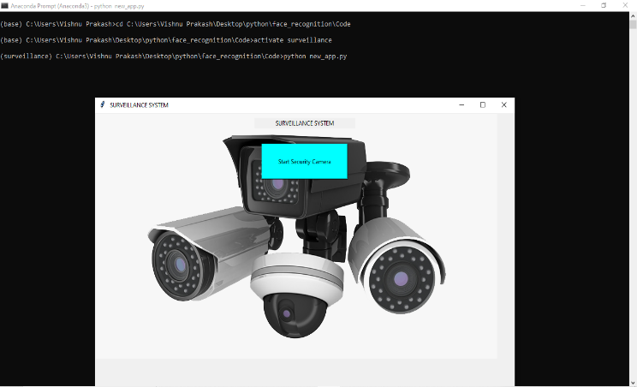

Slide 38
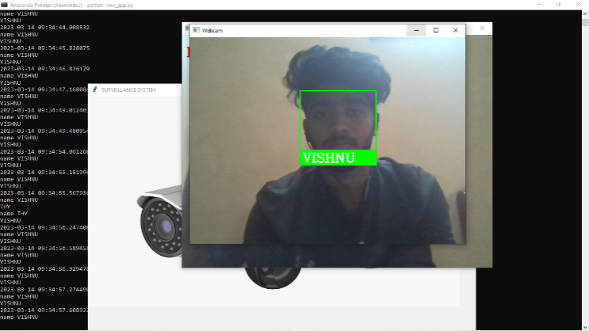

Slide 39
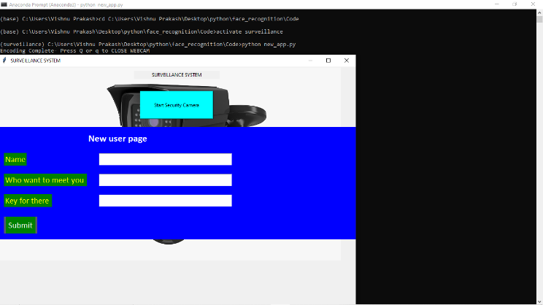

Slide 40
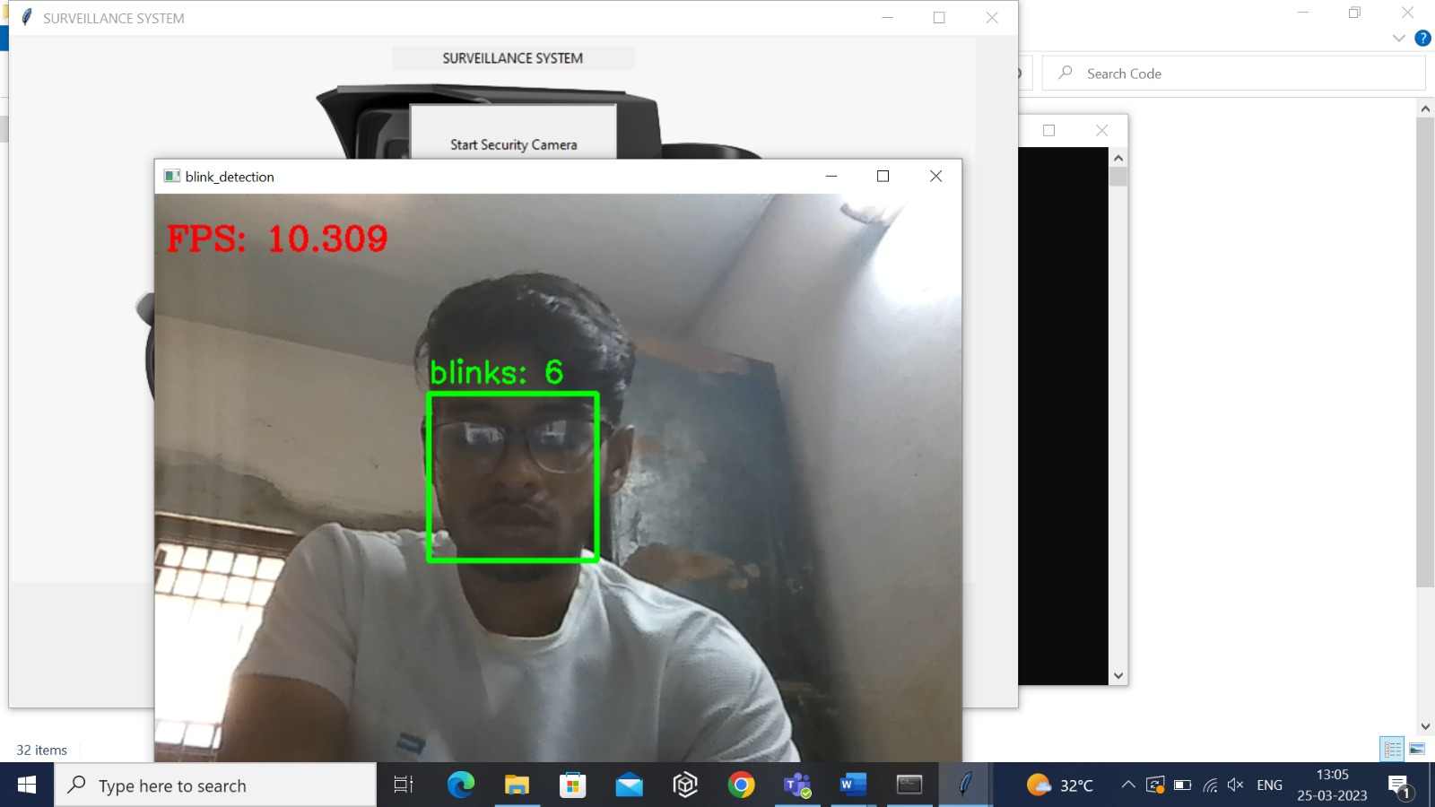

Slide 41
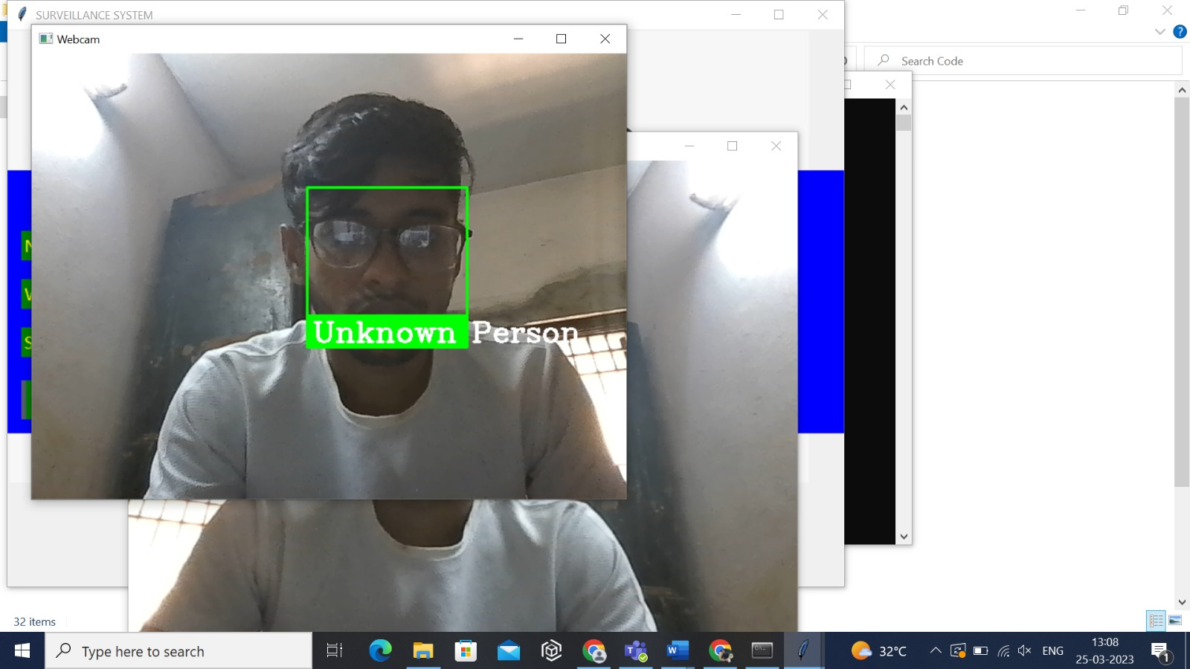

Slide 42


Slide 43


Slide 44
06
CONCLUSION
CLOSURE AND REFERENCES

Slide 45
CLOSURE
The two preventive methods which are Image splitting method and image overlapping method are very effecting image authentication systems. The usual method of shoulder surfing by hackers when they try to overlook someone’s phone or tablet when they enter the password would be effectively prevented when these methods are employed.
The image splitting method which splits the user‘s password image would make it extremely difficult for a hacker to identify the correct grid password. The second method which is Image overlapping method has a series of random numbers which the user must drag to the correct image grid. The randomized number becomes blurred as the user moves them effectively making it impossible to identify the number for a hacker.

Slide 46
REFERENCES
[1] NSA, "Russian State-Sponsored Actors Exploiting Vulnerability in VMware® Workspace ONE Access Using
Compromised Credentials," NSA, 7 Dec 2020. [Online]. Available:
https://media.defense.gov/2020/Dec/07/2002547071/-1/-
1/0/CSA_VMWARE%20ACCESS_U_OO_195976_20.PDF. [Accessed 11 Dec 2020].
[2] S. Reiner, "Golden SAML: Newly Discovered Attack Technique Forges Authentication to Cloud Apps,"
CyberArk,21 Nov 2017. [Online].Available: https://www.cyberark.com/resources/threat-research-blog/golden-saml-
newly-discovered-attack-technique forges-authentication-to-cloud-apps. [Accessed 11 Dec 2020].
[3] Microsoft, "Best practices for securing Active Directory Federation Services," Microsoft, 31 May 2017. [Online].
Available: https://docs.microsoft.com/en-us/windows-server/identity/ad-fs/deployment/best-practices-securing-ad-fs.
[Accessed 9 Dec 2020].

Slide 47
REFERENCES
[4] Microsoft, "Best Practices for Secure Planning and Deployment of AD FS," Microsoft, 31 May 2017. [Online].
Available:https://docs.microsoft.com/en-us/windows-server/identity/ad-fs/design/best-practices-for-secure-planning-
and-deployment-of-adfs. [Accessed 9 Dec 2020].
[5] L. SolarWinds Worldwide, "SolarWinds Security Advisory," 15 December 2020. [Online]. Available:
https://www.solarwinds.com/securityadvisory. [Accessed 15 December 2020].
[6] M. S. R. Center, "Customer Guidance on Recent Nation-State Cyber Attacks," 13 December 2020. [Online].
Available: https://msrc-blog.microsoft.com/2020/12/13/customer-guidance-on-recent-nation-state-cyber-attacks/.
[Accessed 15 December 2020].

